Slide 1
Mobile Robot Path Drift Estimation using Visual Streams

Slide 2
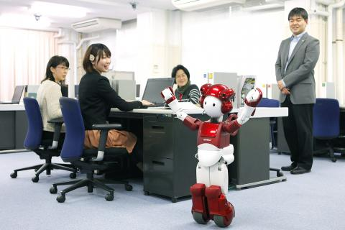
Teach-Replay
Teaching a robot to move along a route
Example: office courier robot

Slide 3
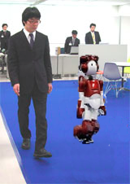
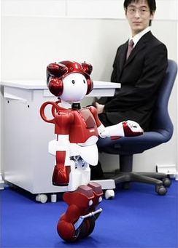
Teach-Replay
Robot is guided along a path

Slide 4
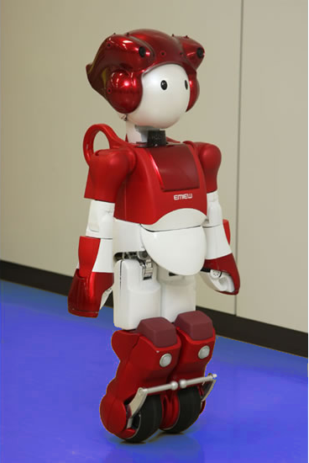
Teach-Replay
Robot retraces guided path autonomously

Slide 5
Teach-Replay
Robot is guided along a path

Slide 6
Teach-Replay
Naive implementation: odometry
(x0, y0, θ0)
(xn, yn, θn)

Slide 7
Teach-Replay
Problem: runaway odometry drift
(x', y', θ')
(x, y, θ)
(Δx, Δy, Δθ)

Slide 8
Topics
Teach-Replay
Appearance-based Navigation
Change Images
Change Vectors
Windowed Cross-correlation
Tests
Conclusion

Slide 9
Appearance-based Navigation
Solution: localization through landmarks
Ir
It
f(It, Ir) ≈ (Δx, Δy, Δθ)

Slide 10
Appearance-based Navigation
Record image streams (continuous sequences)
I'5
I'3
I'4
I'1
I'2
I1
I2
I3
I4
I5
f(It, Ir) ≈ (Δx, Δy, Δθ)
It = {I1, I2, ..., It}
Ir = {I'1, I'2, ..., I't}

Slide 11
Appearance-based Navigation
Recognize landmarks across images
Compare landmark sightings
Respond to perceived changes in landmark location

Slide 12
Topics
Teach-Replay
Appearance-based Navigation
Change Images
Change Vectors
Windowed Cross-correlation
Tests
Conclusion

Slide 13
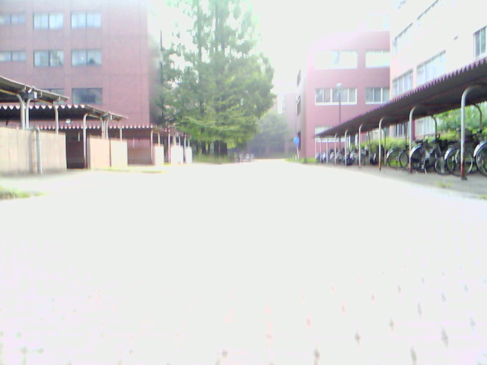
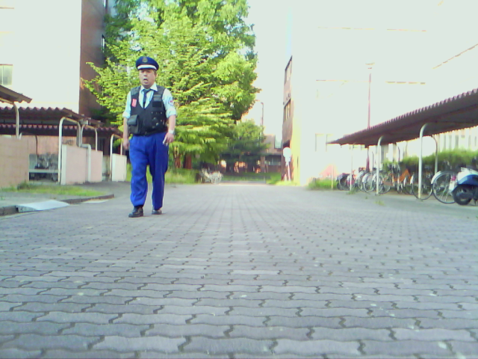
Change Images
How to recognize landmarks across changes in lighting, point-of-view, occlusions, etc?
Need to find and/or compute invariants

Slide 14
Change Images
Compute difference images over image streams

Slide 15
Change Images
Threshold difference images to find regions of high change

Slide 16
Change Images
Average thresholded difference images into change images

Slide 17
Change Images
Change images can be compared for shift

Slide 18
Topics
Teach-Replay
Appearance-based Navigation
Change Images
Change Vectors
Windowed Cross-correlation
Tests
Conclusion

Slide 19
Change Vectors
Left-right shift is a 1D problem

Slide 20
Change Vectors
Collapse change images into 1D change vectors

Slide 21
Change Vectors
Collapse change images into 1D change vectors

Slide 22
Change Vectors
Change vectors make left-right shift calculation easier

Slide 23
Topics
Teach-Replay
Appearance-based Navigation
Change Images
Change Vectors
Windowed Cross-correlation
Tests
Conclusion

Slide 24
Windowed Cross-Correlation
Robust shift calculation against local inconsistencies

Slide 25
Topics
Teach-Replay
Appearance-based Navigation
Change Images
Change Vectors
Windowed Cross-correlation
Tests
Conclusion

Slide 26
Topics
Teach-Replay
Appearance-based Navigation
Change Images
Change Vectors
Windowed Cross-correlation
Tests
Conclusion

Slide 27
DiVS
S =
I0
I1
I2
...
Iw
Iw+1
...
It-w
...
It

Slide 28
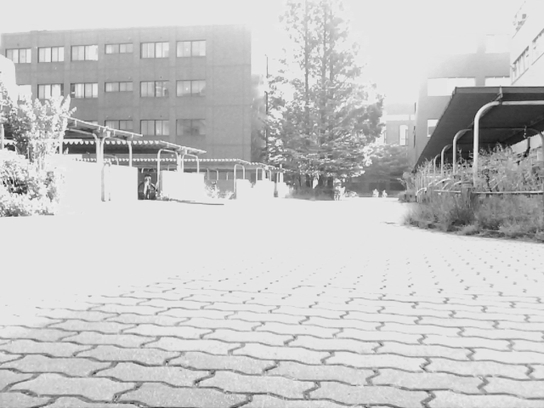
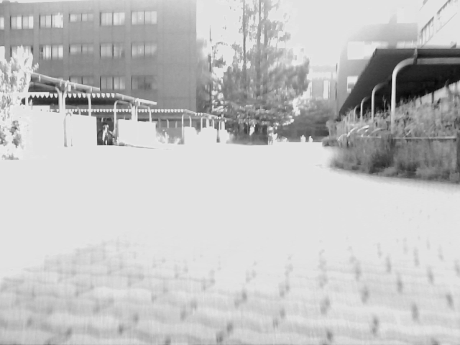
DiVS
-
I0
I1

Slide 29
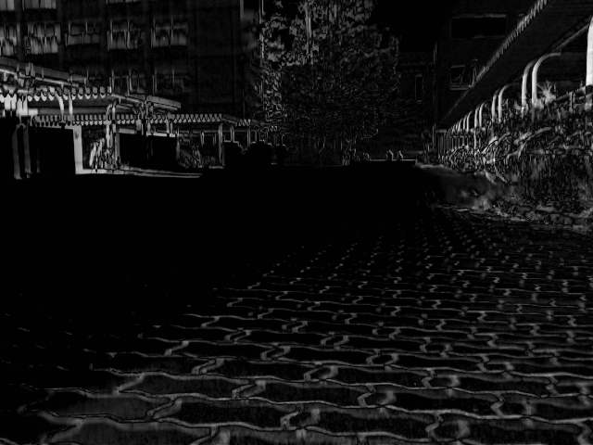
DiVS
D1

Slide 30
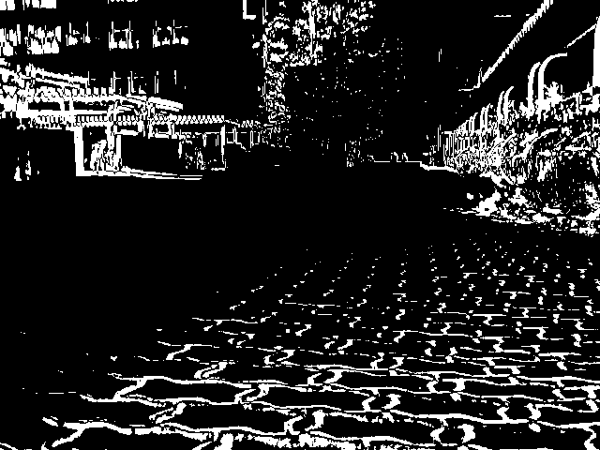
DiVS
B1

Slide 31
DiVS
S =
I0
I1
I2
...
Iw-1
Iw
Iw+1
...
It-w
...
It
B =
B1
B2
...
B
Bw
B
...
B
...
Bt
w-1
w+1
t-w

Slide 32
DiVS
S =
I0
I1
I2
...
Iw-1
Iw
Iw+1
...
It-w
...
It
B =
B1
B2
...
B
Bw
B
...
B
...
Bt
w-1
w+1
t-w
DiVS =
∂w
∂
...
∂
...
∂t
w+1
t-w

Slide 33
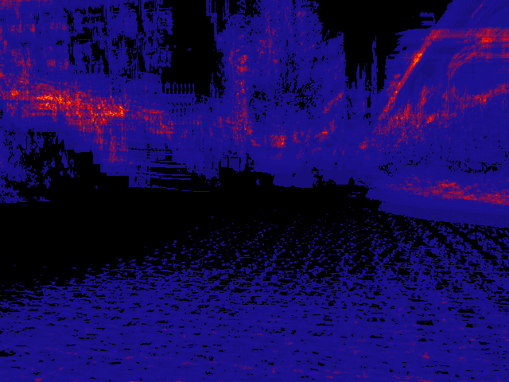
DiVS
∂w

Slide 34
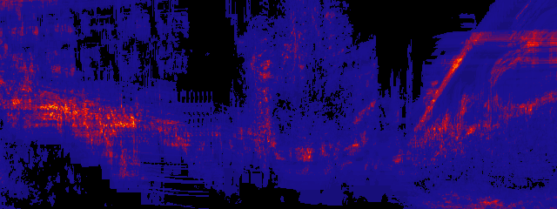
Change Vector

Slide 35
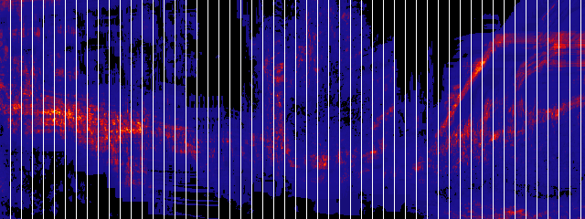
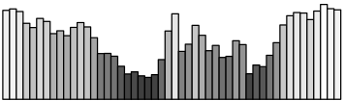
Change Vector
vw =

